Slide 1
Film Analytics
D A T A D A W G S
Siddhant Sutar, Dalton Childers, Neil Matin, Abhimanyu Tomar

Slide 2
TASKS
Siddhant: Machine learning model design and data mining
Dalton: Data acquisition and infrastructure
Neil: Documentation and machine learning research
Abhimanyu: Machine learning research

Slide 3
PROGRESS
Dataset: Movie data for ~1.1 million movies obtained from OMDb, stored in a csv file (size: ~500mb)
Machine learning model: Multiple linear regression

Slide 4
VARIABLES
Independent variables (features):
Rating (PG-13, R, etc.)
Genre(s)
Director(s)
Writer(s)
Actors
Dependent variable (outcome):
IMDb rating

Slide 5
MODEL
Using Pandas, create feature vectors for the independent variables: rating, genre(s), director(s), writer(s), actors. For example, a typical feature vector for actors would be a dataframe that would have movie IDs as rows and list of actors (from the movies in the dataset) as columns. If a specific actor was present in a specific movie, their intersection would have value 1; 0 otherwise.
Concatenate the feature vectors to the original dataframe which has the loaded csv data.

Slide 6

MODEL
Import scikit-learn module, instantiate the linear regression model and “fit” the x and y dataframes corresponding to the user-specified feature columns and the outcome prediction column.
For example, if the user entered “R”, “Quentin Tarantino”, “Leonardo DiCaprio” as the predictors, dataframe x would contain only those columns from the original dataset.
The x corresponds to x-axis which represents the independent variables, and the y corresponds to y-axis which represents the dependent variable in the following multiple linear regression equation:

Slide 7
MODEL
Since all the independent variables are categorical, this is also known as an analysis of variance (ANOVA).
The code for the above linear regression analysis is uploaded to our GitHub repository.

Slide 8
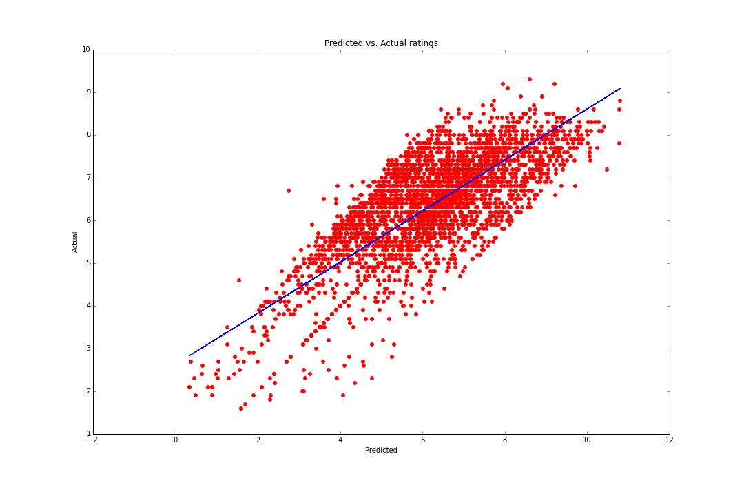
OBSERVATIONS

Slide 9
OBSERVATIONS
Scatter points closely lying around the line of best-fit (blue line), indicating a strong positive correlation between the actual ratings and the predicted ratings.
Root-mean-square error (RMSE): 0.8112

Slide 10
ISSUES
Scaling: the outcome rating with certain predictors crosses the 10 point mark
Memory management: since feature vectors are being created for categorical data, such as multiple actors, currently only considering movies above a certain threshold due to limited processing capabilities on a regular machine. The training dataset includes only movies with more than 1000 votes. (Movie count: 10200, director count: 4528, actor count: 15129)

Slide 11
FUTURE PLANS
Implement support for more features, more outcome predictors: budget (feature), gross (outcome)
Currently working on parsing Rotten Tomatoes movie data to add more predictors such as production houses
Improve memory handling to use more movies and actors, directors in the training dataset

Slide 12
FUTURE PLANS
Incorporate sentiment analysis on plot synopsis using naïve Bayes classification and Python’s NLTK library; movie plots with a rating of 7.5 are considered positive. Add plot keywords as predictor features
Look at other possible machine learning models, such as generalized additive model (GAM), and compare the results

